Slide 1
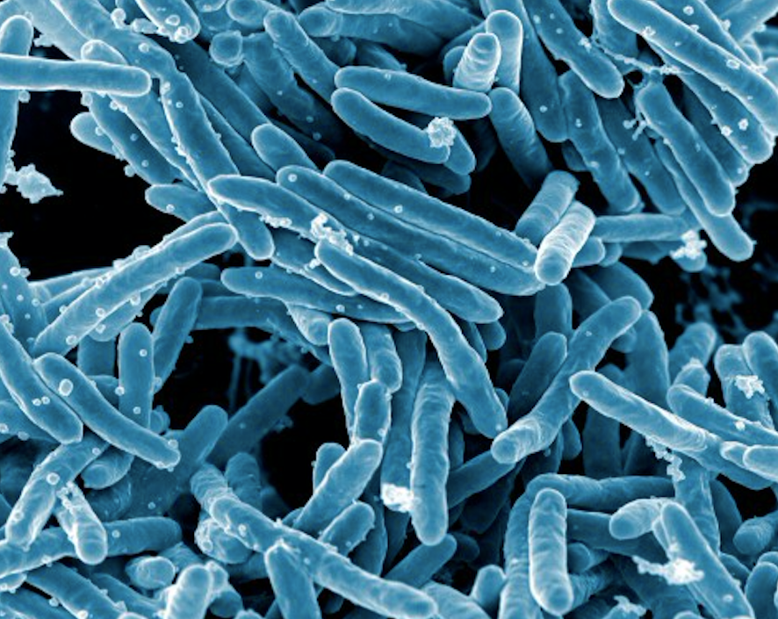
TUBERCULOSIS
This Photo by Unknown Author is licensed under CC BY

Slide 2
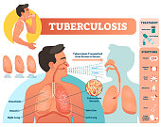
WHAT IS TUBERCULOSIS
Tuberculosis (TB) is a serious illness that mainly affects the lungs. The germs that caused the tuberculosis are a type of a bacteria.

Slide 3
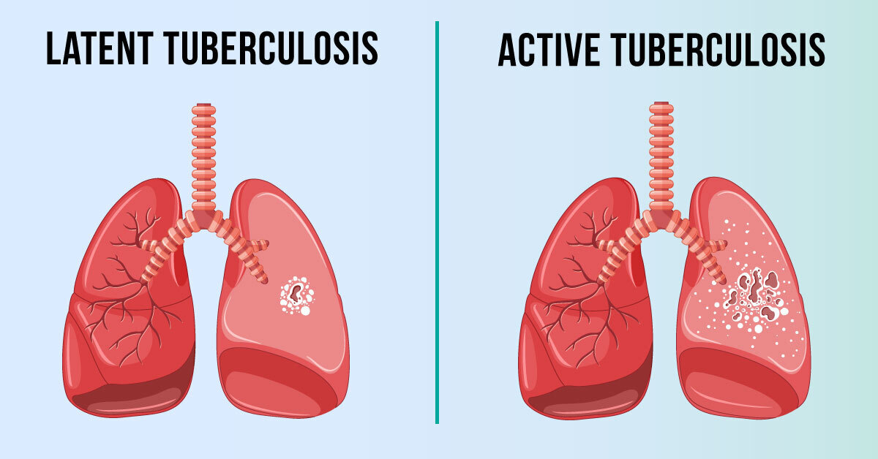
Types of tuberculosis
ACTIVE TUBERCULOSIS
LATENT TUBERCULOSIS
PULMONARY TUBERCULOSIS
EXTRAPULMONARY TUBERCULOSIS
SKELETAL TUBERCULOSIS
MILIARY TUBERCULOSIS

Slide 4
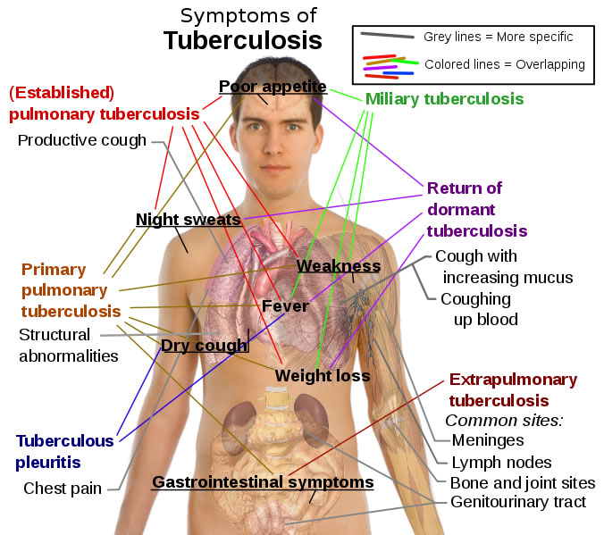
SYMPTOMS OF TUBERCULOSIS
FEVER
NIGHT SWEATS
PRESISTENT COUGH
CHEST PAIN OR SHORTNESS OF BREATH.
BLOOD PHLEGM
VOICE HAARSENESS.

Slide 5
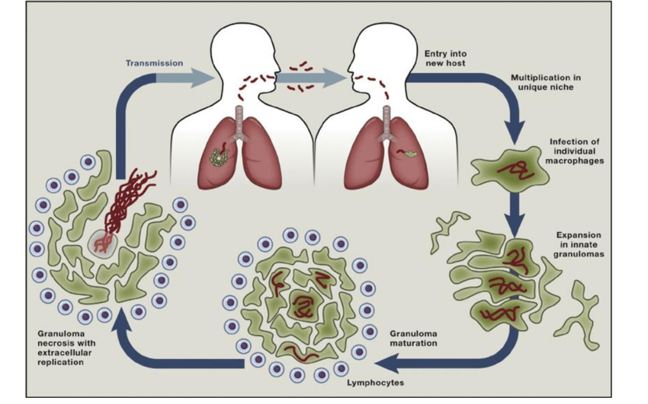
HOW TO PREVENT IT
STAY INDOORS , AVOID GOING TO PUBLIC PLACES.
CURB THE STREAT.
BOOST YOUR IMMUNITY
AT HOME USE A SEPARATE BED TO SLEEP.
ALWAYS COVER YOUR MOUTH ON THE TISSUE.
MAKE SURE YOUR ROOM IS WELL VENTILATED.

Slide 6
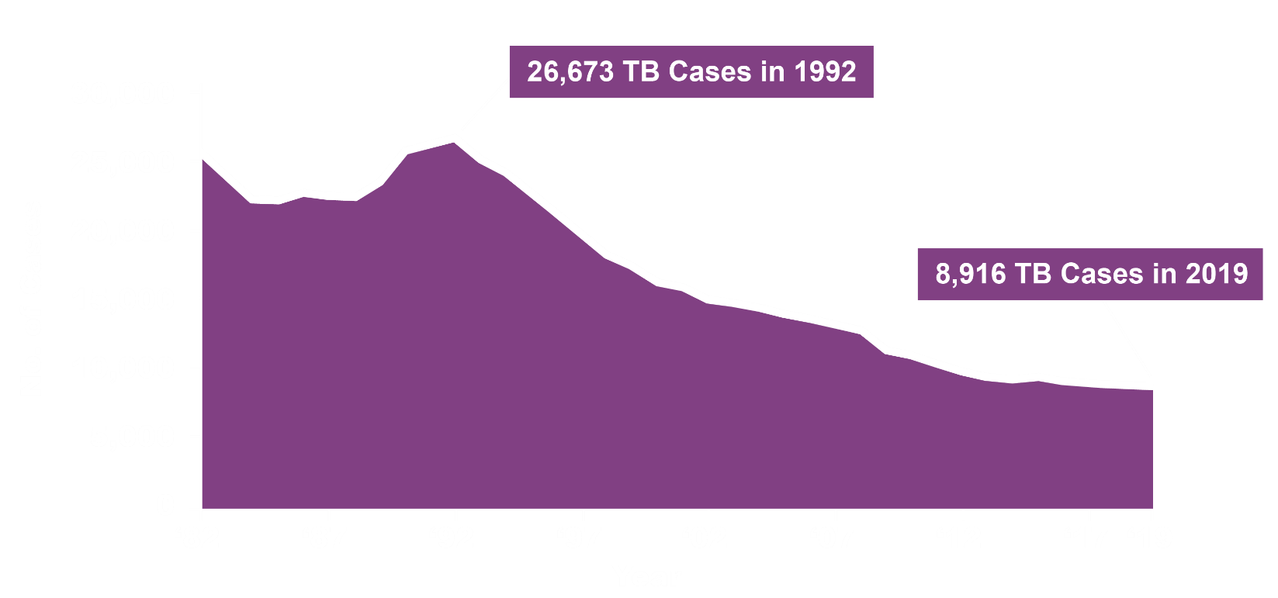
Progress Toward TB Elimination, United States, 1982-2019
Notes:
This graph shows the number of TB cases for each year from 1982 to 2019 (the most recent year for which TB data are available). In 1992, the U.S. had the highest number of reported TB cases during this period.
2019 saw the lowest number of US TB cases and lowest incidence rate on record, continuing a trend of declining cases and incidence since 1992.
Reaching the goal of TB elimination in the United States requires maintaining and strengthening current TB control priorities, while increasing efforts to identify and treat latent TB infection (LTBI) among high-risk populations. The TB elimination threshold is <1 case per 1,000,000 population, which is approximately 330 cases per year for the current U.S. population.
For more information: https://www.cdc.gov/tb/statistics/default.htm

Slide 7
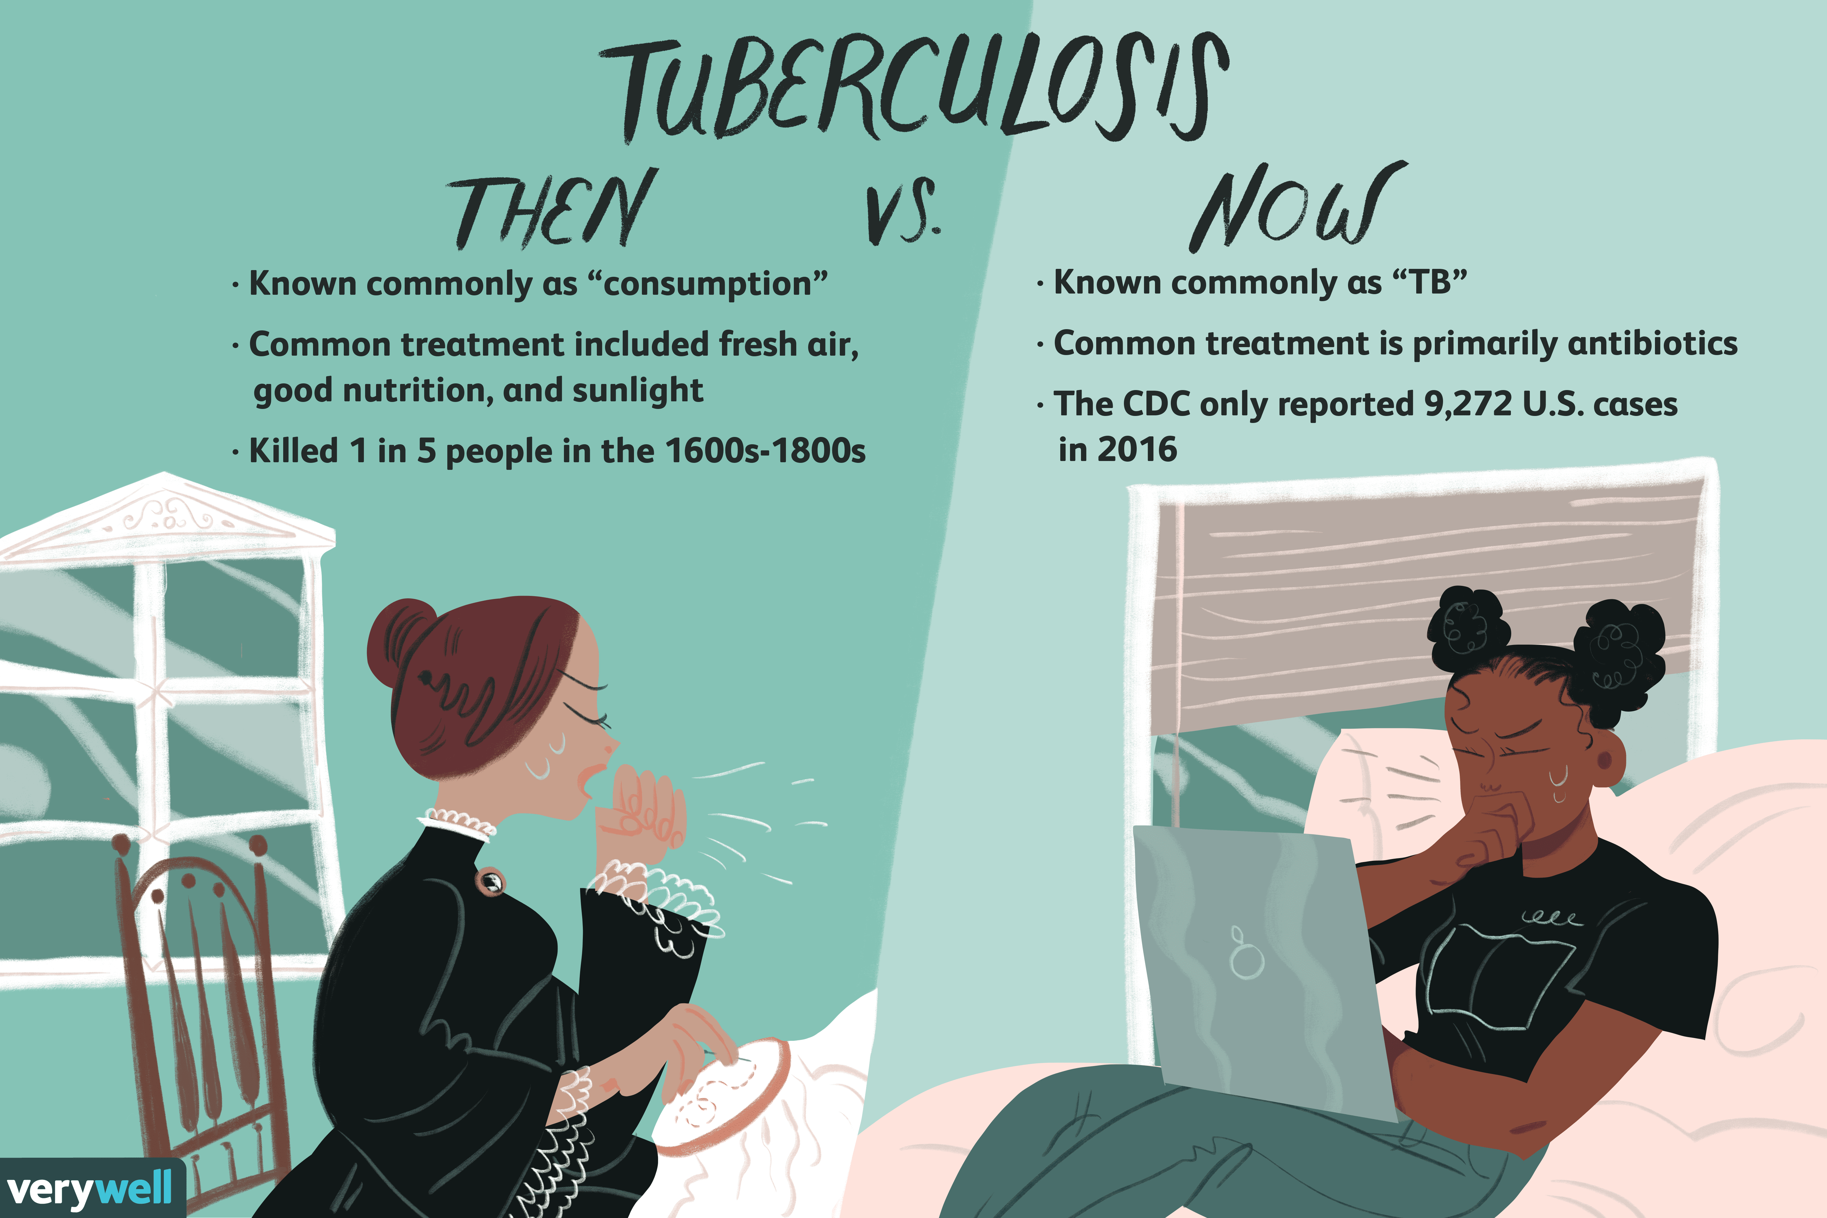
WHAT ARE THE CONSEQUENCES
TUBERCULOSIS (TB) a disease caused by germs that are spread from person to person through the air . TB usually affects the lungs, but it can also affects other parts of the body , such as the brain , the kidneys or the spine . A person with TB can die if they do not get treatment .

Slide 8
What is tb free India
TCL Foundation , has collaborated with the International Union Again . Tuberculosis lung disease to help India in its fight against TB . At the national level . TCI Foundation support the Government of India is cell to action for a TB – Free India to end TB in India

Slide 9
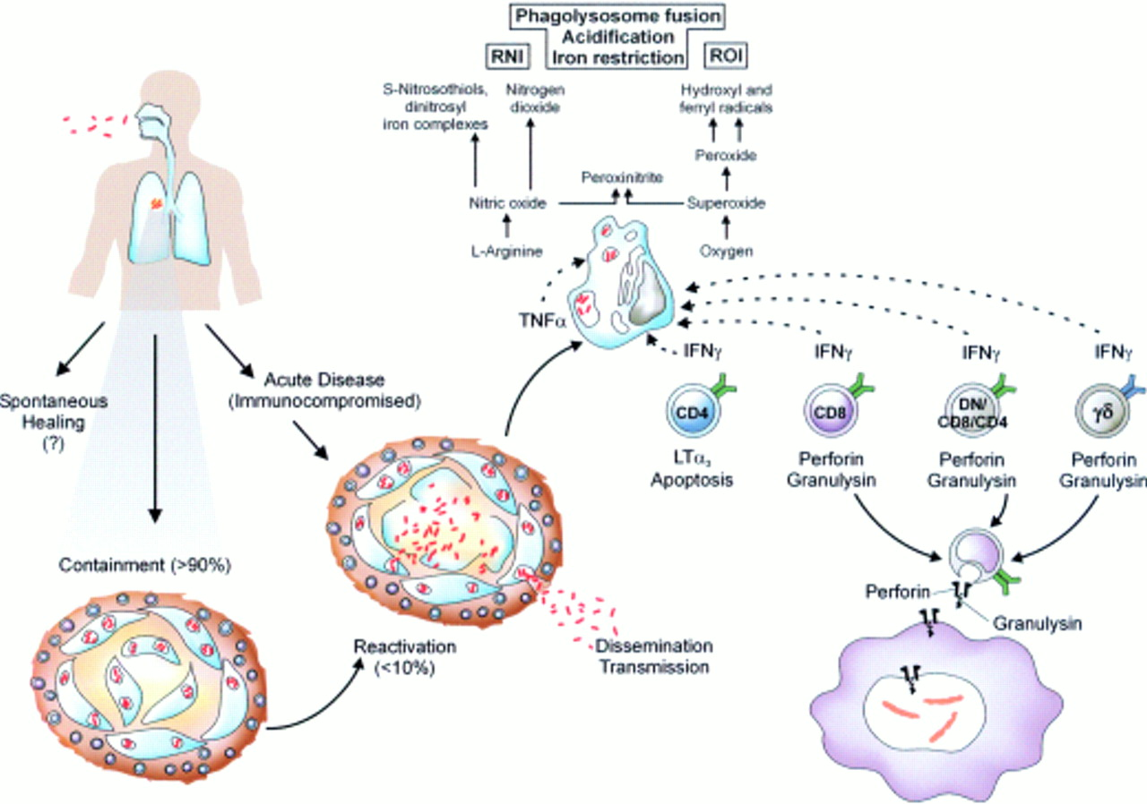
Health care and providers and communities need to think “tb”
Protect the health and well being of community members at higher risk for TB.
Know who is most at risk for TB.
Recognize the signs and symptoms of TB.
Test and treat patients who are at high risk for TB.
Be aware of latest TB research and shortest treatment options.
Encourage conversations about TB and hoe it affect the community to reduce stigma.

Slide 10
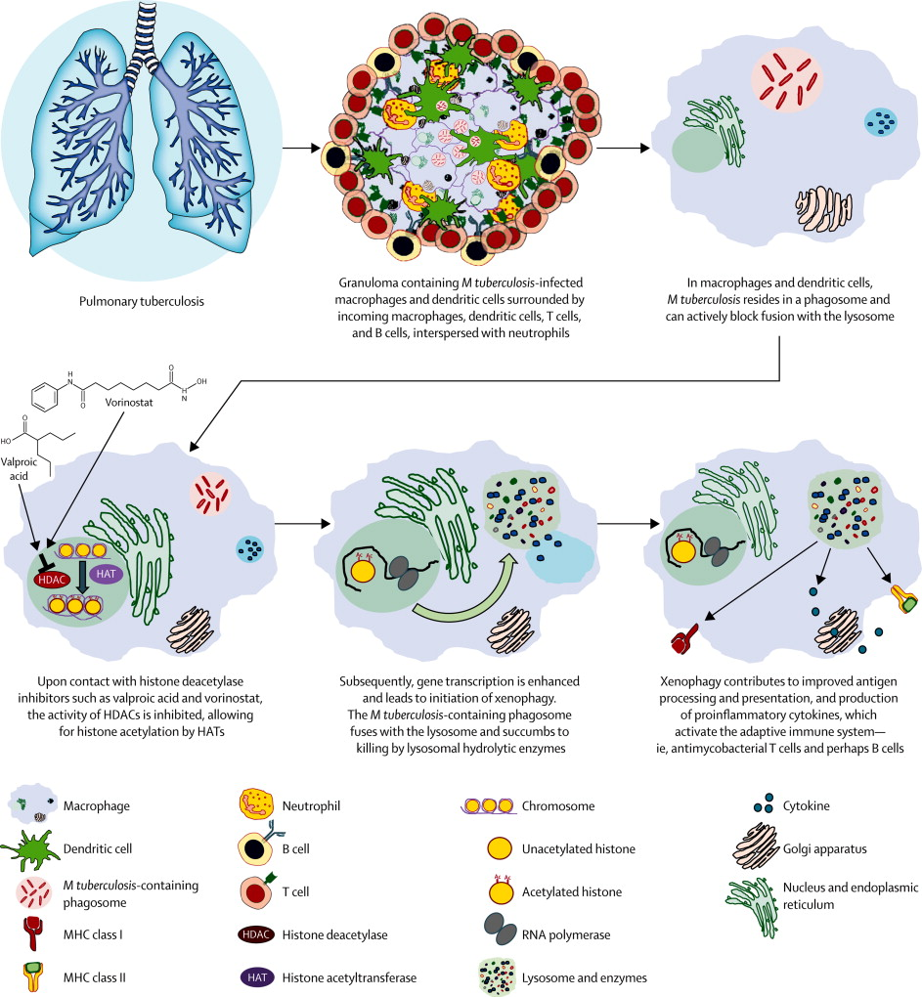
Principles of tuberculosis
Always treat with more than one drug.
Six months regimens are effective for susceptible isolates.
Consider treating all patients is with directly observed therapy.
Extrapulmonary disease is treated like pulmonary disease.
Add two new drugs to a failing regimen.

Slide 11
conclusion
Abdominal tuberculosis , a frequently recognized from extrapulmonary tuberculosis is increasing with increasing frequency of HIV infections. Ahigh index clinical suspicion appropriate and timely investigation, early diagnoses and treatment that considerably reduce the morbidity and mortality from this curable but potentially lethal disease.

Slide 12
topic “tuberculosis” Why I think choose
Because in our world most people have suffering this diseases and children and pregnant women . So this reason. I am telling more person how to save it.

Slide 13


THANK YOU FOR LISTEN ME

